Slide 1
Appendix F C Programming Environment on UNIX Systems
Chien-Chung Shen
CIS/UD
cshen@udel.edu

Slide 2
Unix Programming Tools
子曰:「工欲善其事, 必先利其器」
Confucius said:
Craftsmen must first sharpen their tools before they can do a good job

Slide 3
What to Know
Know your tools
gcc, gdb, ld
Know your libraries
libc, linked with all C programs by default — all you need to do is include the right header files
Know your documentation
manual (man) pages

Slide 4
Sample C Program (hw.c)
Telling C preprocessor (cpp) to find a particular file (e.g., stdio.h) and to insert it into the code at the spot of #include
By default, cpp looks in directory /usr/include/ to find the file

Slide 5
Compilation and Execution
$ gcc hw.c (gcc is a compiler “driver”)
gcc executes cpp, the C preprocessor, to process certain directives (such as #define and #include [cpp is just a source-to-source translator, so its end-product is still source code (i.e., a C file)]
Then the real compilation begins, usually a command called cc1, which transforms source-level C code into low-level assembly code, specific to the host machine
The assembler as will then be executed, generating object code (bits and things that machines can really understand)
Finally link-editor (or linker) ld will put it all together into a final executable (program), a.out by default
./a.out
int main(int argc, char *argv[])
argc is 1, argv[0] points to string ./a.out, and argv[1] is 0

Slide 6
Useful Flags
Flags can be combined

Slide 7
Linking with Libraries
C library is automatically linked with every program
Need to find the right #include file via manual (man) pages
E.g., $ man fork
#include <unistd.h>
E.g., $ man tan
some library routines do not reside in C library
link C program with math library (in /usr/lib)

Slide 8
Types of Libraries
Statically-linked libraries (which end in .a)
libraries are combined directly into your executable; i.e., the low-level code for the library is inserted into your executable by the linker
results in a much larger binary object
Dynamically-linked libraries (which end in .so)
just include reference to a library in executable; when the program is run, the operating system loader dynamically links in the library when used
preferred over static approach because (1) it saves disk space (no unnecessarily large executables are made) and (2) allows applications to share library code and static data in memory

Slide 9
Linking with Libraries
$ gcc -o hw hw.c -Wall -lm
The -lZZZ flag tells linker to look for libZZZ.so (first) or libZZZ.a
Want the compiler to search for headers in a different path than the usual places, or want it to link with libraries that you specify
use compiler flag -I/foo to look for headers in directory /foo, and flag -L/bar to look for libraries in directory /bar
The -I flag should go on a compile line, and the -L flag on the link line

Slide 10
Separate Compilation
compile lines
link line
The -c flag tells the compiler just to produce an object file (hw.o and helper.o)
Link object files into an executable
$ gcc -o hw hw.o helper.o -lm
only ld is invoked
The -I flag should go on a compile line, and the -L flag on the link line
$ gcc -Wall -O -o hw hw.c helper.c
-o vs. -O

Slide 11
Makefile
saved in a file called Makefile (or makefile)
Automate build process
$ make
On Linux, gmake (Gnu make) and make are one and the same

Slide 12
Makefile
Makefiles are based on rules, which are used to decide what needs to happen
Target: name of a file that is generated by a command or name of an action to carry out
Prerequisite: a file that is used as input to create the target
Command: an action that make carries out
You have to put a single tab character at the beginning of every command line!

Slide 13
Makefile
hw.c
helper.c
hw.o
helper.o
hw
If hw.c has been modified more recently than hw.o has been created, make will know that hw.o is out of date and should be generated anew; in that case, it will execute the command line, gcc -O -Wall -c hw.c, which generates hw.o
No prerequisites for clean → just execute the command(s)

Slide 14
easily add new source files into your build, simply by adding them to the SRCS variable

Slide 15
Debugging - gdb
Gnu debugger
Compile with –g, but not –O
run
break <function name>
break <line #>
print <variable name>
next/step
Multiple source files
b file name:line #

Slide 16
Documentation
Use these tools
Read more about them from their man pages
$ man gdb
Man pages are divided into sections
kill command kill() system call
kill –s # name
$ man man

Slide 17
C Pointers
Pointers are powerful features of C programming that differentiates it from other popular programming languages like Java and Python
Pointers are used in C program to access memory and manipulate address

Slide 18
Address in C
#include <stdio.h>
int main()
{
int var = 5; // variable
printf("Value: %d\n", var);
printf("Address: %u", &var); // address of var
return 0;
}

Slide 19
& and *
& is called reference operator, which gives you the address of a variable
* is called dereference operator, which gets you the value from the address

Slide 20
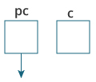


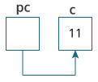
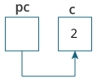
Pointer
#include <stdio.h>
int main()
{
int* pc, c;
c = 22;
printf("Address of c: %u\n", &c);
printf("Value of c: %d\n\n", c);
pc = &c;
printf("Address of pointer pc: %u\n", pc);
printf("Content of pointer pc: %d\n\n", *pc);
c = 11;
printf("Address of pointer pc: %u\n", pc);
printf("Content of pointer pc: %d\n\n", *pc);
*pc = 2;
printf("Address of c: %u\n", &c);
printf("Value of c: %d\n\n", c);
return 0;
}

Slide 21
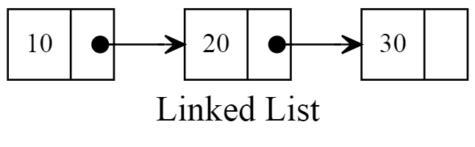
C struct
struct mp3 {
char *name;
struct mp3 *next;
};
struct mp3 one;
struct mp3 *two;
typedef struct mp3 {
char *name;
struct mp3 *next;
} mp3_t;
mp3_t one;
mp3_t *two;
The notion of type (class) is fundamental to CS!
Turing Award lecture: The Power of Abstraction, B. Liskov
https://amturing.acm.org/vp/liskov_1108679.cfm

